Slide 1
Writing As A Process
Department of English
Faculty of Social Sciences
College of Humanities and Social Sciences
Kwame Nkrumah University of Science and Technology

Slide 2
Some Approaches to Writing
Product approach
Genre approach
Process approach

Slide 3
The Process Approach
The Process Approach aims to reflect what real writers do in real situations.
It considers writing as non-linear

Slide 4
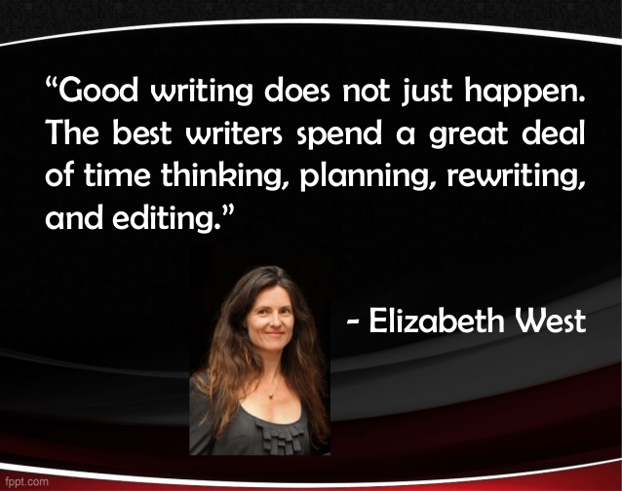
Views on Process Approach to Writing 1

Slide 5
Views on Process Approach to Writing 2
Writing is messy, recursive, convoluted, and uneven. Writers write, plan, revise, anticipate, and review throughout the writing process, moving back and forth.
The process approach appeals to ‘common sense’ and many life activities such as cooking, sweeping, dressing, and even vocations sewing, carpentry, painting, etc.
The motto of the Process Approach is: Writing is rewriting.
The process approach focuses on the steps involved in creating a piece of work.

Slide 6
Views on Process Approach to Writing 3
Good writers organize, plan, and re-write throughout the writing process, changing things lots of times if necessary, and writing multiple drafts
Good writers may rehearse or discuss what they want to write before they actually do it
Good writers read their writing carefully, trying to imagine how clear their ideas are to a reader. If something isn’t clear, they change it.
Writing is a process which requires several identifiable steps.

Slide 7
What the Process Approach emphasizes
the importance of writing multiple drafts
the importance of revision
the importance of planning throughout
the importance of making your writing reader-friendly
the importance of writing in different styles for different audiences

Slide 8
Stages/Steps in Process Approach 1
Prewriting Stage (select a topic and plan what to write)
Writing Stage (Provide drafts, revise and keeping making changes.
Post-writing Stage
(edit and proofread the work, publish)

Slide 9
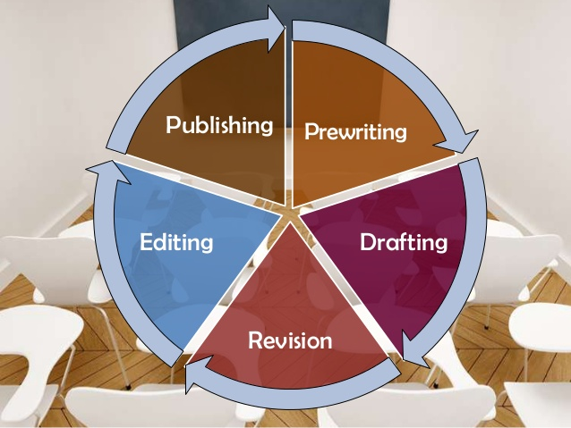
Stages/Steps in Process Approach 2

Slide 10
THE PRE-WRITING STAGE

Slide 11
Sub-steps in the pre-writing: Define your audience (audience analysis) 1
Know the audience you are writing to:
Gender
Age
Status
Religion
Educational background
Nationality
Belief systems/ideology

Slide 12
Sub-steps in the pre-writing: Topic selection 2
Factors to Consider in Selecting a topic.
Relevance
Availability of resources
Availability of information
Accessibility of information
Personal interest
Strength or competence
Duration (time assigned)
Length of the work
NB: The topic should not be too narrow nor broad.

Slide 13
After selecting the topic, what next?

Slide 14
The Vice Chancellor, as part of her “Motivating- Students-to-Excel Agenda” has donated GhS20, 000.00 to this class. What must we use the money for?

Slide 15
Students’ Activity: Let’s Generate Ideas
1.
2.
3.
4.
5.
6.
7.
8.
9.
10.
Etc.

Slide 16
Sub-steps in the pre-writing: Brainstorming 3
It is a creativity technique by which efforts are made to gather a list of ideas spontaneously.
People are able to think more freely and they suggest as many spontaneous new ideas as possible. All the ideas are noted down without criticism and after the brainstorming session the ideas are evaluated.

Slide 17
Rules Underpinning Brainstorming
Go for quantity: This rule is a means of enhancing divergent production, aiming at facilitation of problem solution through the maxim quantity breeds quality.
Withhold criticism: Criticism of ideas generated should be put 'on hold'. Focus on extending or adding to ideas. Reserve criticism for a later 'critical stage' of the process.
Welcome wild ideas: To get a good long list of suggestions, wild ideas are encouraged. They can be generated by looking at new perspectives and suspending assumptions.
Combine and improve ideas: Build ideas by a process of association/clustering.

Slide 18
Sub-steps in the pre-writing: Clustering 4
It is a way of narrowing your thoughts by classifying related ideas.
Cluster analysis or clustering is the task of grouping ideas such that those in the same group are more similar to each other than to those in other groups.
See the next slide

Slide 19
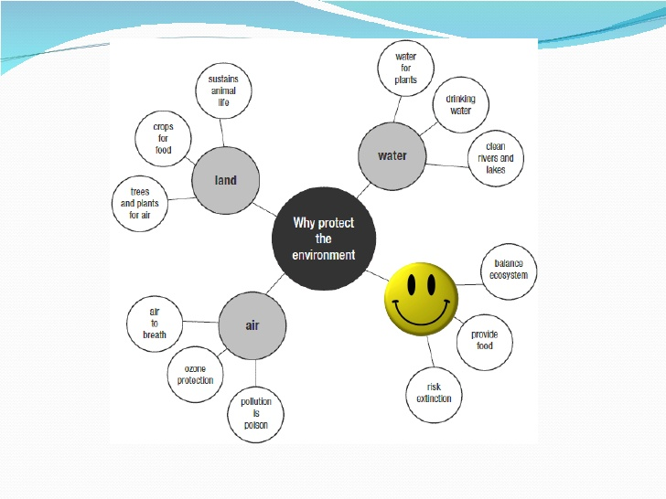

Slide 20
Sub-steps in the pre-writing: Outlining 5
An outline is a way of organizing key ideas
An outline helps to set up an essay or a research paper
An outline is a tool to help revise an essay or research paper.
An outline can be a study tool to help you summarize key ideas in reading

Slide 21
Outlining
It is the skeleton of the main points or ideas of an already written essay, or a yet-to-be-written essay
Types: formal and informal

Slide 22
THE FORMAL OUTLINE
A formal outline shows, in logical order, what you will be writing about.
A formal outline helps you separate main ideas and supporting ideas
A formal outline gives you a foundation from which to build an introduction, a body, and a conclusion.
A formal outline often changes after you write your first draft. It will show you where you need to add more research or make other changes.

Slide 23
Principles of Outlining
Heading
Labeling (numbering) NB: Ideas of the same rank are given the same label.
Structuring (topic or sentence forms)

Slide 24
Addressing Immigration Challenges
I Introduction
* Criteria for immigration
A. Political refugees
B. Relatives of citizens
C. Other applications
II. Screening Criteria
1. Medical Screening
2. Interview
3. Psychological screening
4. Background check
III. Students
1. Purpose of study
2. Commitment to study
A. How long will they stay?
B. How will they finance their education and support themselves?
3. Value to our educational system
IV. . Government oversight
1. Obligation to have periodic checks on immigrants and students
2. Reporting any legal violations or suspicious behavior
3. The government needs to limit the number of immigrants
V.. Conclusion

Slide 25
THE WRITING STAGE
Freewriting on the developed outline (No focus on grammar and language)
Produce a draft
Revise the drafts severally

Slide 26
Post-writing Stage: Editing & Proofreading

Slide 27
TYPES OF EDITING
Self-editing
Peer-editing
Group-editing

Slide 28
The State Protocol Department has denied claims by the founder of the Ghana Freedom Party (GFP), Madam Akua Donkor that they have been given express instructions not to invite her and Dr Hassan Ayariga to state functions. Madam Akua Donkor disclosed that she does not receive invites as she used to and in an attempt to find out from the State Protocol Department (SPD), she was told by one Mensah that her name is not among persons to be invited for such events as directed by the presidency. Akua Donkor believes the current President, Nana Addo Dankwa Akufo-Addo despises not only her but Dr Hassan Ayariga of the All Peoples Congress (NDC) for which reason they have both been relegated to the background. “Nana Addo does not like me and Hassan Ayariga. I am sure that is why he has directed them not invite me for state functions but I don’t care”, he revealed on Kumasi-based Abusua Fm. But Deputy Chief Protocol Officer at the State protocol department Nana Mensah refuted claims that he refused to give her invite adding that the President had no hand in the protocol list. According to him, the GFP leader knows the processes involved in extending such invitations denying the claim that they showed her a list which did not contain her name. ‘Prior to the Independence Day for example, I told her to hang around for a while because the one in charge of invitation cards had stepped out, the time I realised, she had left unannounced. She knows how we have been assisting her even when she wants to travel outside the country. I am just wondering why she has decided to go to the media with such an issue. If it is also about the State of the Nation Address, we at SPD do not handle that, Parliament does,’ he explained.

Slide 29
FOCUS OF EDITING: CONTENT 1
Relevance
Adequacy
Consistency
Accuracy

Slide 30
FOCUS OF EDITING: STRUCTURE 2
Generic requirements (letter, memo, abstract, etc.)
Well-organized (introduction, developing paragraphs, and concluding paragraphs)
Logical sequencing
Transitional markers

Slide 31
FOCUS OF EDITING: CLARITY 3
At word, phrase, clausal, and sentence levels
Ambiguity and vagueness
Dangling or misrelated constructions
Sentence fragments and run-on sentences
Awkward sentences
Inappropriate lexical choices

Slide 32
FOCUS OF EDITING: STYLE 4
Level of formality
Appropriate tone
Sentence beginning, length, variety, and complexity
Paragraph length
Gender-sensitive language
Nominalized
Verbalized
N.B. Many factors affect style: aim, audience, and topic

Slide 33
FOCUS OF EDITING: FORMATTING 5
Lecturer’s/department’s/institution’s guidelines
Spacing, font size, font type,
Margins
Bold, italics, underlining
Pagination
Table, figure, and chart
References/Bibliography
Word limit

Slide 34
FOCUS OF EDITING: CONCISENESS 6
Replace several vague words with specific words
Adopt effective sentence combining practices
Replace a phrase with a word
Dispense with words that have very little utility value: ‘actually’, ‘basically’, ‘practically’
Avoid redundancies: ‘basic fundamentals’, ‘free gift’, ‘large in size’, ‘round in shape’

Slide 35
PROOFREADING
This may be termed surface revision. It largely focuses on the mechanics of the language use.

Slide 36
FOCUS OF PROOREADING
Concord
Spelling
Punctuation
Tense
Repetition of words (e.g. Africans must be be patriotic)

Slide 37
SOME GUIDELINES FOR EDITING/PROOFREADING
Maintain some distance from the text in terms of time
Decide what medium allows you to edit most carefully
Find a quiet place
Edit and proofread in several short blocks of time, rather than all at once

